Slide 1
IDAC
Doing the Work

Slide 2
Welcome & Call to Order
Citizen Comments
Approval of Minutes

Slide 3
Introduction of Subject Matter Experts (SMEs)
Finance: Nicole Conley Food Services: Anneliese Tanner
Legal: Ylise Janssen Human Resources: Dora Fabelo
Athletics: Leal Anderson Transportation: Kris Hafezizadeh
Programs & Initiatives: Rachel Naugle
Site Based Decision Making: Joey Crumley
Welcome to any new members and district staff!
Notes:
Have SMEs rotate around the work group tables to chime in.

Slide 4
Why do students attend charter schools?
Joey Crumley shares information about charter schools.
Notes:
Handout 4

Slide 5
Direction of the District
Rachel Naugle shares information about programs and initiatives.

Slide 6
Roadmap to Reinvention
Reinvention through the Lens of a District of Innovation

Slide 7
Language Acquisition
Roadmap
Expand Spanish Dual Language
Launch Arabic and Chinese Dual Language
Expand Middle School Dual Language
Launch High School Dual Language
Create a World Languages Academy
Newcomer Program
Possible TEC Exemptions:
Ch. 21 – Certification; Contract
Ch. 25 – First/Last Day of school; length of school day

Slide 8
College Readiness
Roadmap
Expand ECHS to Lanier, Eastside, Crocket
MicroMajors
OnRamps – Dual Credit Courses
Edgenuity – Online Coursework
PTECH – Grade 9-14 ECHS; includes internships
Possible TEC Exemptions:
Ch. 21 – Contracts; Minimum personal leave
Ch. 25 – Minimum attendance for class credit; Class size

Slide 9
Equity
Roadmap
Socioeconomic Integration
My Brother’s Keeper mentor program
Criteria for Application-Based Programming
Gifted/Talented Program Redesign
Possible TEC Exemptions
Ch. 11 – School uniforms
Ch. 25 – First/Last day of school; Minimum attendance; class size; length of school day

Slide 10
SEL/Whole Child
Roadmap
Integrate SEL into curriculum
Expand Creative Learning Initiative
Cultural Proficiency
Restorative Justice
Possible TEC Exemptions
Ch. 25 – Length of school day; first/last day of school

Slide 11
Innovative Programming/School Models
Roadmap
Autism Academy
Dyslexia Middle School Academy
Montessori Program
Possible TEC Exemptions
Ch. 21 – Certification; contracts
Ch. 25 – First/last day of school; length of school day

Slide 12
Academic Redesign
Roadmap
Performance tasks as assessments
Online Learning Positioning System – BLEND
Problem-Based Learning
Standards Based Grading
Possible TEC Exemptions
Ch. 25 – First/last day of school; minimum attendance; class size

Slide 13
Extended Education Opportunities
Roadmap
Afterschool programs standardization
Online Credit Recovery Programs
Middle School credit recovery during school year
Enhance Evening School programs
Possible TEC Exemptions
Ch. 21 – Planning & prep time
Ch. 25 – Minimum attendance; length of school day; class size

Slide 14
Review of Meeting Outcomes

Slide 15
Proposed IDAC Committee Work & Timelines
Meeting 1 January 11, 2017 at the AISD PAC
Outcomes:
Learn about HB 1842 and Districts of Innovation
Review committee charge
Gather input on innovative ideas
Meeting 2 January 18, 2017 at the AISD PAC & Meeting 3 January 25, 2017 at Reagan High School:
Outcomes:
Identify TEC exemptions that correspond to innovative suggestions
Provide input on processes for campuses to apply for exemptions
Notes:
We will move the “provide input on processes for campuses to apply for exemptions” to another meeting agenda to allow more time to explore the TEC.

Slide 16
Proposed Committee Work & Timelines continued
Add a possible work session day to continue identifying applicable TEC exemptions (if needed) and what we want our draft our plan to look like. Do we want to do this?
Meeting 4 February 1, 2017 at the AISD PAC
Outcomes:
Draft and review the innovation plan
Address any needed revisions
Meeting 5 February 8, 2017 at Reagan High School:
Outcomes:
Finalize the innovation plan
Ensure the draft plan is ready to share with the DAC and the Board of Trustees on or before April 10, 2017
An additional meeting could be organized if needed to address revisions suggested by DAC or School Board

Slide 17
Today’s Task
Use feedback forms (and group discussion/ideas) to clearly articulate the innovation or challenge in column 1on the Exemption Rationale form.
Think about/discuss how the innovation or challenge might be impacted by the Texas Education Code, and make any notes in column 2.
Use the Possible Exemptions list to identify areas of the TEC that might apply and read applicable policies. Research relevant sections of the TEC. List all applicable sections of the TEC in column 3.
Use the AISD Strategic Plan to list portions of it that are supported by the exemption in column 4.
Decide as a group whether you mostly agree with or oppose the exemption and list agree or oppose in column 5. Also list any concerns, limitations you feel should apply, and any additional information you feel is needed.
Consult with SMEs as needed to gather information.
Notes:
Handout 5 - Groups 1-3 Feedback Forms (couple of copies per work group)
Handout 6 - Exemption Rationale form (copy for each member)
Handout 7 - Possible Exemptions Forms (copy for each member)
Handout 8 - TEC for Possible Exemptions (couple of copies per work group)
Handout 8.1 - TEC for Possible Exemptions Summarized (couple of copies per work group)
Handout 8.2 - Innovation TIPS with TEC References (couple of copies per work group)
LAPTOPS WILL BE NEEDED TO LOOK UP OTHER PORTIONS OF THE TEC (Website link given on a future slide)
Handout 9 - AISD Strategic Plan (couple of copies per work group)

Slide 18
Let's look at a sample...
Notes:
Handout 10 - Sample Feedback form
Handout 11 - Sample Exemption Rationale form filled in

Slide 19
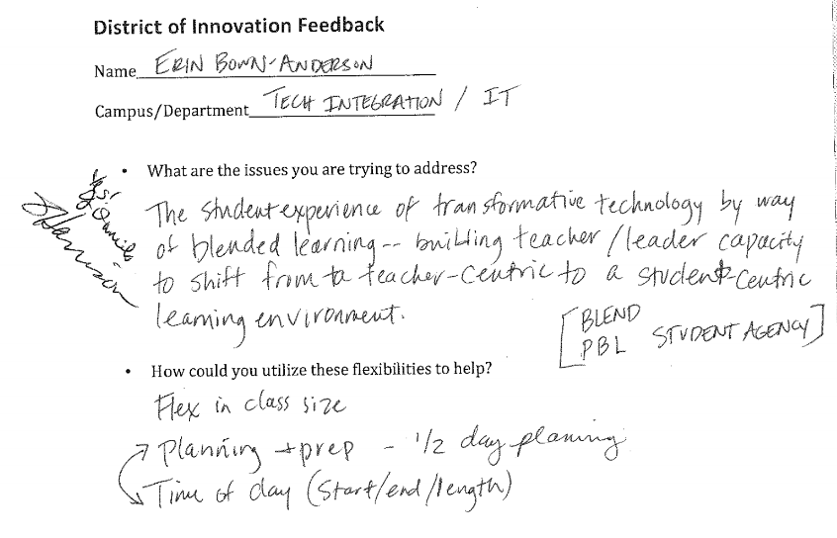

Slide 20
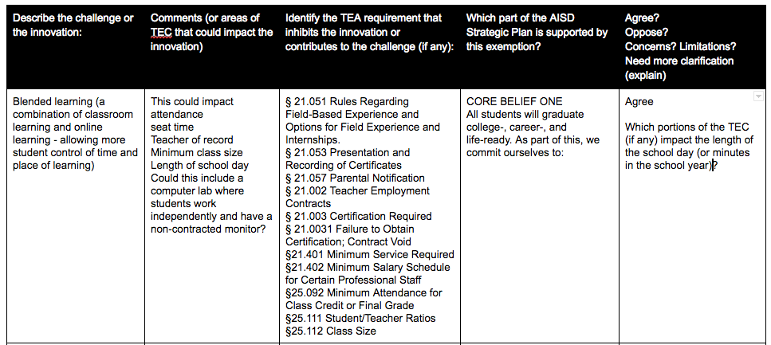

Slide 21
Breaking Up Into Groups...
Group 1: Staff Development / Campus & District Operations
With Jennifer Pace
Planning time, Length of school day/ start & stop time, school calendar, transportation, teacher appraisals, time to analyze student work, early release days, attendance reporting options, transportation ideas,excessive service contract requirements
http://bit.ly/2jWK7bU
Group 2: Staffing
With Raul Sanchez
Class size flexibility, behavior coordinators, teachers vs. TAs in special education, work experience vs. teacher certification, flexible grouping, options in start/stop time
http://bit.ly/2jwIvZE
Group 3: Academic Programs
With Rachel Naugle
STEM & CTE programming, options for advanced & struggling learners, off-campus programs, credit recovery options, extended day, weekend and summer options, year-round, interventions, opportunities for applications in the real world, internships, length of school day based on student need, on-line courses, Flexibility with textbook funds, 90% attendance rule
http://bit.ly/2juFLfB
Notes:
3 tables/work groups activity --- llet people decide where they want to go.
Ask folks to move if we are not evenly distributed, so that we have around 10 at each table.
Have a copy of the sorted feedback handouts at each workgroup area, plus laptops.
Links to the group Google Docs are shown.

Slide 22
Look out for...
things we don’t need exemptions for, such as “offering a wide variety of classes” or “implementing standards-based grading”. This does not need to be included on the Exemption Rationale form. But feel free to let this spark conversation that may lead to other innovative ideas with related exemptions you want to include on the form.
Also look out for things that might not be possible, like “funding for an additional teacher” or things we cannot exempt ourselves from, like our state-mandated curriculum. But consider possible creative alternatives to achieve the desired outcome.
Notes:
If in doubt add to the form and list your questions in the far right column.

Slide 23
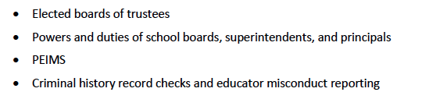
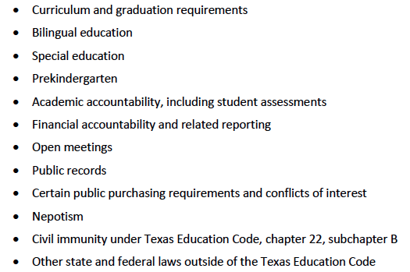
Reminder of what is NOT eligible for exemptions

Slide 24
Useful Sites for looking up policy
Texas Constitution & Statutes (Education Code)
http://www.statutes.legis.state.tx.us/?link=ED
19 Texas Administrative Code (TAC) Part II: Texas Education Agency
http://ritter.tea.state.tx.us/rules/tac/index.html

Slide 25
Debrief & Plan for Next Meeting
Group share out
How many feedback forms still need to be reviewed?
Were any innovations strongly opposed?
Review information needed
Determine the need for an additional meeting

