Slide 1
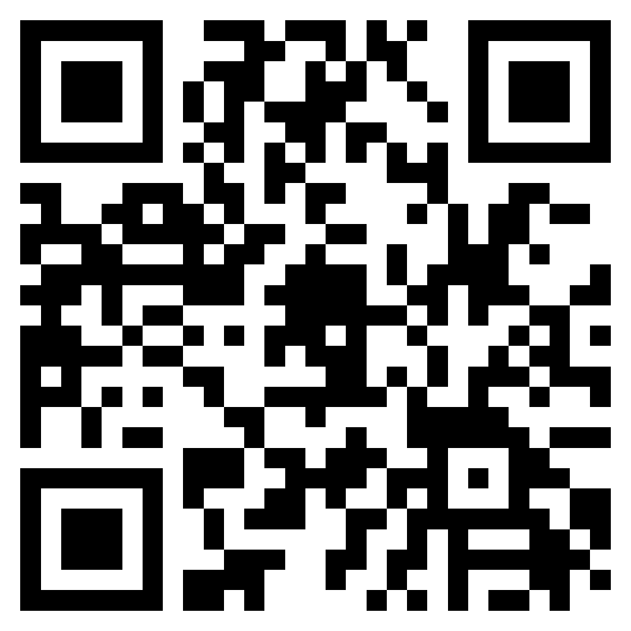

Bond Steering Committee / Comité Directivo del Bono Public Comment Registrations / Inscripció para presentar un comentario público
Ten minutes for public comment
Two minutes per person
Register using the QR Code or https://tinyurl.com/aisd2022bond
The committee follows the district’s Communications and Visitor Requirements
Diez minutos para comentarios públicos
Dos minutos por persona.
Regístrese usando el código QR o https://tinyurl.com/aisd2022bond
El comité sigue los requisitos de visitantes y comunicaciones del distrito

Slide 2

Interpretation
Notes:
Co-chairs - Carmen

Slide 3
Bond Steering Committee / Comité Directivo del Bono Public Comment Registrations / Inscripció para presentar un comentario público
Ten minutes for public comment
Two minutes per person
Register using the QR Code or https://tinyurl.com/aisd2022bond
The committee follows the district’s Communications and Visitor Requirements
Diez minutos para comentarios públicos
Dos minutos por persona.
Regístrese usando el código QR o https://tinyurl.com/aisd2022bond
El comité sigue los requisitos de visitantes y comunicaciones del distrito

Slide 4
Bond Steering Committee
Saturday, June 11, 2022
Notes:
Frank/Co-Chairs

Slide 5
Call to Order
Notes:
Frank/Co-Chairs

Slide 6
Public Comment
Notes:
Co-Chairs

Slide 7
Agenda
Notes:
Co-chairs

Slide 8
 | AGENDA ITEM | START * | DURATION
1. | Call to Order | 9:00 a.m.
2. | Public Comment | 9:00 a.m. | 10 min
3. | Approval of Meeting Minutes from the May 18, 2022, May 25, 2022 and June 1, 2022 meetings | 9:10 a.m. | 10 min
4. | Presentation and Discussion of Bond Planning, including: ● Implications to District Infrastructure without a Capital Infusion ● History of Long-Range Planning Process and Campus/Community Engagement ● Long-Range Planning Strategies (not costed) ● Defining Mission Critical Building Systems ● Facility Condition Assessment data (costed) | 9:20 a.m. | 3 hours, 35 min
5. | Potential Future Items for Discussion, Meeting Dates/Times, Locations; Meeting Duration | 12:55 p.m. | 5 min
6. | Adjourn* | 1:00 p.m.
Notes:
Co-chairs

Slide 9
Approval of the Minutes
May 18, 2022
Notes:
Co-Chairs

Slide 10
Approval of the Minutes
May 25, 2022
Notes:
Co-Chairs

Slide 11
Approval of the Minutes
June 1, 2022
Notes:
Co-Chairs

Slide 12
Recap of Previous Meetings & Expectations
Notes:
Ed

Slide 13
Our Role
Honor people’s time and keep the discussion on track
Ensure all voices are heard
Keep the student experience at the center
Assist with tradeoffs
Ensure we adhere to your commitments
Notes:
Frances

Slide 14
Meeting Norms
Say your name before speaking. That helps everybody in the room and those on the other side of the camera.
If you are participating virtually, please keep your camera on (if possible). Your presence is important to all of us.
Be mindful of being a dominant voice. We want to hear all voices.
Share and make space for others to share questions and perspectives.
One mic, one voice.
Speak from the “I” perspective.
Notes:
Frances

Slide 15
Recap of Previous BSC Meetings
Building a bond program
Pebbles, boulders and buckets
Review of historical bond program data
StoryMap
2013 and 2017 projects update
Bond project life cycle and budgets
Escalation
Project construction
Soft costs
Equity workshops
Notes:
Frances

Slide 16
June 11 Meeting Goals
Discuss the need for a Nov. 2022 bond election
Understand LRP and BSC process and engagement
Understand the Long-range Planning Committees’ decision-making framework
Understand FCA deficiencies needed to keep schools operational and open
Notes:
Frances

Slide 17
What Happens If We Do Nothing?

Slide 18
What Happens If We Do Nothing
Potential New Legislation and Timing
Two Texas Senate Committees (Education and Local Government) are currently reviewing school district bond issuance and bond election requirements.
Bills in previous sessions contained burdensome ballot language and other requirements, including a requirement that every individual project be listed as a separate proposition.
Even unpopular bills can be added to popular ones. Example: THIS IS A TAX INCREASE language was added to the School Finance Bill (HB 3, 2019) late in the session.
The Board of Trustees in their Legislative Priorities have historically opposed restrictive bond language, separate propositions, and the requirement to hold elections only in November.
Likely Effect of Legislation Passed in Upcoming Session:
May 6, 2023 (called by Feb 17, 2023) - Not affected by upcoming session
Nov. 2023 - (called in August 2023) - Likely not affected depending on effective date of legislation
Elections after Nov. 2023 - will be likely be affected by any changes passed in the upcoming session.
Notes:
Education Committee, Bond Efficiency: Conduct a comprehensive review of the school district bond issuance process. Specifically, review public notice and disclosure requirements, the bond election process, procurement requirements, and how unused bond proceeds may be utilized. Study the best practices implemented by school boards and make recommendations to improve bond issuance efficiencies.
Local Government Committee, Bond Elections: Review and report on voter participation and bond election result differences between November and May elections. Make recommendations for improved voter turnout, increased election efficiencies, and better accountability of local debt.

Slide 19
What Happens If We Do Nothing
Escalation
Assuming escalation of 12 percent/year on $1.5B for 1 year = $1.5B x .12 = $180M
$180M = approximately 3 modernized elementary schools at $60 million each (project cost)
Safety and Security
All modernized schools include enhanced safety/security features
Transportation
30 bus replacements/year = approximately $5M
Delay of 1 year means $5M x .12 (escalation) = $600,000
Delay until May
Waiting until May actually sets projects back an entire year, not just 6 months
Notes:
Education Committee, Bond Efficiency: Conduct a comprehensive review of the school district bond issuance process. Specifically, review public notice and disclosure requirements, the bond election process, procurement requirements, and how unused bond proceeds may be utilized. Study the best practices implemented by school boards and make recommendations to improve bond issuance efficiencies.
Local Government Committee, Bond Elections: Review and report on voter participation and bond election result differences between November and May elections. Make recommendations for improved voter turnout, increased election efficiencies, and better accountability of local debt.

Slide 20
The Cost of Doing Nothing
Emergency repairs
In 2021-22 Austin ISD spent $1,720,363 on A/C Rental Equipment (Boilers and Chillers). That is equivalent to 25 teachers with benefits.
Utility costs (Energy Efficiency Fact Sheets: tinyurl.com/AISD2017BondEnergy)
Govalle and Menchaca utility cost savings in Year 1: $74,833. That is equivalent to 1 teacher with benefits
Modernized Govalle Elementary is in the nation’s top 5% for energy performance in K-12 schools.
Modernized Menchaca Elementary:
68% reduction in the operating costs associated with energy consumption.
Went from one of the least efficient schools in the nation (lowest 6% of K-12 schools nationwide) to top 16% in the nation.
16 solar roof installations would save $4.14M in energy costs over 25 years. Equivalent to 61 teachers over that time period or 2.5 teachers per year.
Winter Storm Uri Damage
Modernized campus had little to no damage from the storm

Slide 21
Committee Examples
The student experience
Co-chair discussions
Notes:
Frances tell co-chairs to give one minute examples and ask if one or two other want to share quickly . Aiden is willing to speak from student perspective.

Slide 22
Committee Survey

Slide 23
Live Results
After hearing from district staff and committee members,
which best describes your thoughts?
No bond
We should stop this process, the district does not need a bond.
We have time
We should continue planning, but for a later bond cycle.
There is too much at stake
We need to get a bond package together for this November 2022.

Slide 24
Process and Engagement
How we got here and engagement to date

Slide 25
How We Got Here
FCA/ ESA* Start
Final Data
Sep. 2021
Final Packages
Feb. 2022
FCA & ESA
LRP Committee Listen and Identify Unmet Needs
Sep.- Dec. 2021
Ongoing Meetings to Develop Long-range Plan
Jan.- July 2022
Draft Long-range Plan
May 2022
Present Long-range Plan to Board
Jun. 2022
Long-range Planning (LRP)
BSC First Meeting
Mar. 15, 2022
BSC Second Meeting
Mar. 30, 2022
Ongoing Meetings to Develop Bond Plan
May - Aug. 2022
Last Day to Call the Election
August 22, 2022
Election
Nov. 8, 2022
Bond Steering Committee (BSC)
Committee Work
Support/ Estimating
Estimating Efforts and Support
Mar.-Aug. 2022
LEGEND
Information handff
Milestones

Slide 26

Long-range Planning Process
Draft Strategic Implementation Plan: Long-range Plan
Draft Strategic Implementation Plan: 2022 Bond
Identify Underserved Communities: Data webinar
Environmental Scan and Asset Mapping: Data collection, qualitative feedback from “Listen” phase
Develop Research-based Bond-related Strategies: LPC meetings, campus/community engagement, surveys
Develop Research-based Non-bond-related Strategies: LPC meetings, campus/community engagement, surveys
Listen: Phone outreach, small group discussions, PSS and staff interviews
Research Promising Practices: Office of Equity research
Root Cause Analysis: Surveys, LPC workshops
Establish Goals: LPC meetings and workshops, AVID student insights

Slide 27
Community Engagement
2 ESA/FCA and Ed Spec info sessions & 88 survey responses (July 2021)
3 Districtwide Kick-off Community Panels and Conversations (Sept. 2021)
82 Outreach phone calls (Oct. 2021)
109 Stakeholder and small group meetings (fall 2021-present)
29 CAC meetings
8 PTA meetings
23 Principal Coffees/Parent Chats
6 Neighborhood groups
6 Parent Support Specialists Focus Groups
3 Staff meetings
23 Community organizations
11 End of year campus events (field days, student performances, enrollment clinics, etc.)
24 LPC meetings (fall 2021-present)
862 6th–10th grade AVID student participants from 5 campuses (April 2022)
Eastside ECHS, Martin MS, Murchison MS, Oak Springs ES, Bertha Sadler Means YWLA
546 Survey participants (Jan. 2022-present)
Notes:
We designed our engagement efforts to gather a diversity of perspectives to ensure our decisions meet the needs of students and families that our education system has most historically underserved.

Slide 28
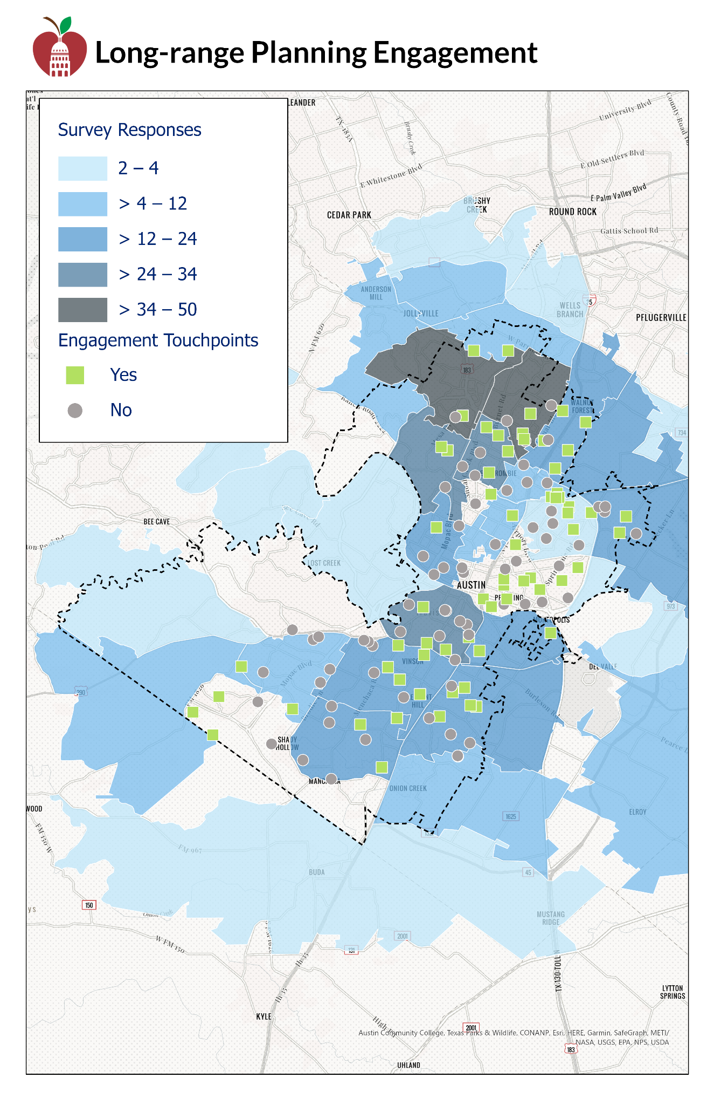
Map of LRP Engagement Efforts
Visit https://bit.ly/LRPMAP to view an interactive version of the engagement map.

Slide 29
Ongoing Engagement Process
Continued engagement around non-bond related LRP strategies among high opportunity school communities
BSC Meetings - public comment
Tentative July Community Meetings to present the initial draft bond package:
Tuesday, July 12, virtual
Thursday, July 14, virtual
Saturday, July 16, in-person opportunity north and south
Dates will be promoted as soon a engagement plan is finalized

Slide 30
Break

Slide 31
Long-range Plan Strategies
Decision-Making Framework and Update

Slide 32
Long-range Plan Decision Making Framework
Part 1: Equity Rubric
(Prioritizing the ‘What’)
Part 2: Comparing ‘LRP Opportunity Index’ with strategy-specific data (Identifying the ‘Where’) with some exceptions
Equity by Design Strategies at Historically Underserved Campuses
Consideration for
Bond Funding
32
Notes:
Listening to community
Develop Problem Statements
Root Cause Analysis
Set Goals
Develop strategies to address root causes
Prioritize strategies
While all strategies will go through Part 1 (prioritizing the “what” based on the equity rubric), there are other strategies that don’t neatly align with Part 2’s process (“where” they are implemented). Examples of this include, but are not limited to:
District-wide technology updates
Bus replacements
Proposed projects resulting from these exceptions will be identified and delivered to the BSC. The method of identifying these exceptions will vary based on the specifics of the strategy.

Slide 33
Part 1: Prioritizing the What
Equity Rubric - Guiding Pillars
(Informed by Equity-Focused Decision-Making)
Prioritize Long-range Planning Committee strategies which…
…were informed by diverse people and perspectives (Engagement)
…address predictable and systemic harm on students and staff from underserved communities (Harm)
…directly address root causes (Root Causes)
…are based on supporting evidence (Evidence)
…impact learners as often as possible (Frequency)
Notes:
https://docs.google.com/spreadsheets/d/1L0AsMXltOo6jb8PTApk0tYDjo16dhEaI/edit#gid=492666385

Slide 34
Part 2: Identifying the Where
To ensure we are reaching historically underserved students and not furthering the inequities caused by previous methods of decision-making, we will prioritize implementing projects at “High Opportunity” facilities as defined through the LRP Opportunity Index.

Slide 35
Part 2: High Opportunity Facilities
A facility is listed as "High Opportunity" if one of the following conditions are met:
If the school enrollment has a high number of underserved students in the highest quintile (top 20%) across the district AND has a high neighborhood vulnerability (using the CDC’s social vulnerability index and calculated by averaging the SVI of each census tract in its attendance area), or
If there are 3 or more identified groups of underserved students in the top two quintiles (top 40%) across the district, regardless of neighborhood vulnerability, or
If it is a central or district-wide facility that is in a census tract that has a high neighborhood vulnerability

Slide 36
Part 2: High Opportunity Facilities
Allison Elementary
Alternative Learning Center
Andrews Elementary
Barrington Elementary
Brown Elementary
Burnet Middle
Clifton Career Development School
Cook Elementary
Delco Center
Dobie Middle
Eastside Early College High
Galindo Elementary
Garcia YMLA
Govalle Elementary
Graham Elementary
Guerrero Thompson Elementary
Harris Elementary
Hart Elementary
Houston Elementary
International High
Jordan Elementary
Langford Elementary
LBJ Early College High
Linder Elementary
Lively Middle
Martin Middle
McBee Elementary
Mendez Middle
Navarro Early College High
Nelson Bus Terminal
Nelson Field
Noack Sports Complex
Norman-Sims Elementary
Northeast Early College High
Oak Springs Elementary
Odom Elementary
Ortega Elementary
Overton Elementary
Padron Elementary
Palm Elementary
Pecan Springs Elementary
Perez Elementary
Pickle Elementary
Pleasant Hill Elementary
Reilly Elementary
Rodriguez Elementary
Sadler Means YWLA
Sanchez Elementary
Service Center
Southeast Bus Terminal
St. Elmo Elementary
Travis Early College High
Travis Heights Elementary
Uphaus Early Childhood Center
Walnut Creek Elementary
Webb Middle
Widen Elementary
Winn Elementary
Wooldridge Elementary
Wooten Elementary
Zavala Elementary

Slide 37
Part 2: High Opportunity Facilities
Where possible, data points for each strategy have been identified. These often align with specific sub-scores or specific questions from the ESA.
Example:
VAPA strategy: “Ensure VAPA classes have a facility that matches the programmatic needs”
Potential data point: VAPA ESA Sub-score (which measures how rehearsal and support spaces align with the ed spec)
link to example ESA Summary and Full Report

Slide 38
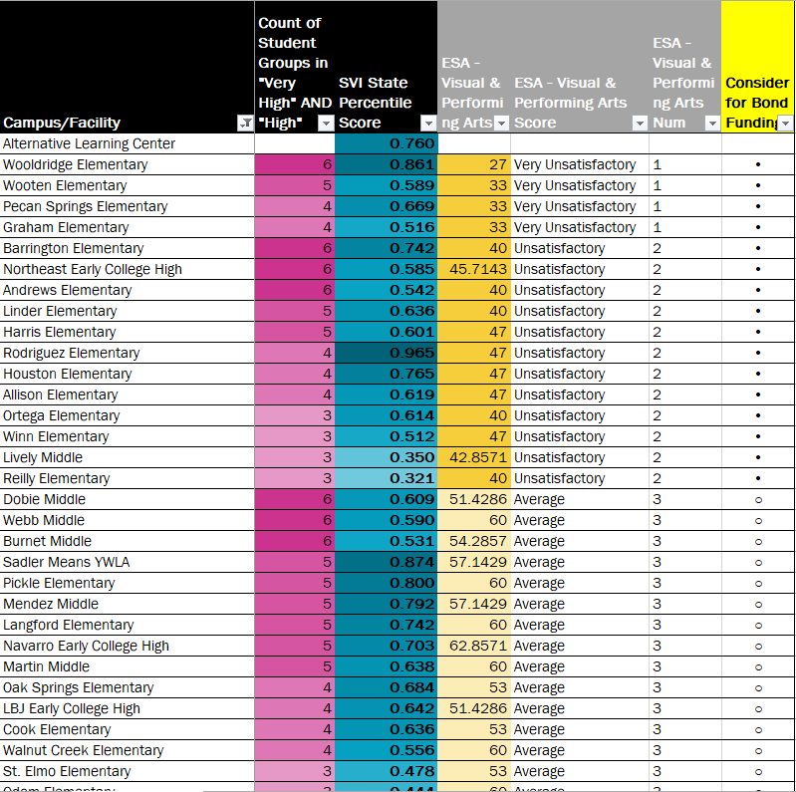
Part 2: High Opportunity Facilities Rubric
This priority list is used as a starting point.
LPC project managers and AISD subject matter experts will determine the location and project for the specific strategies.
If multiple strategies occur at a campus, a modernization of that school may be considered.

Slide 39
Long-range Plan Update: Bond Funded Strategies
Two committees, Transportation, Food Service and Maintenance and Safety, Security and Resiliency have finalized their prioritization of strategies (Part 1) and have prioritized the locations for them (Part 2).
All other committees are anticipated to complete their work early next week.
Notes:
Need to add transition from LRP strategies and just fixing what is broken. Not ready to discuss LRP strategies so today is focusing on the FCA or the building systems that are broken now. HVAC is a good example to give.

Slide 40




































What are your pebbles and boulders
Safety + Security
Athletics
FCA & ESA Deficiencies
Long-range Plan
FCA
ESA
Technology
Fine Arts
Transportation
Other Needs Identified During the Process
Facilities
Academics + CTE

Slide 41
FCA Deficiencies
What We Know
The scope of work and cost for the FCA Deficiencies that need to be done for schools to remain open.
LRP Facilities Committee’s first priority: Mission Critical Building Systems: Facilities with mission critical building systems issues should be prioritized above all other projects to resolve those specific issues and prioritize student health, safety, & welfare.
Notes:
Jamal will stop sharing his screen and Randall will begin sharing his and walking the group through the tool with Michael directing

Slide 42
Break

Slide 43
FCA Deficiencies
Notes:
Michael

Slide 44
FCA Deficiencies
Costs for FCA Report Years 0-10 (all FCA priority levels) - $2.7 billion
Cost for FCA Report Years 0-5 (all FCA priority levels) - $1.8 billion
Cost for FCA Report Year 0 (all FCA priority levels) - $522 million
Notes:
Michael

Slide 45
FCA Deficiencies
Priority 1 – Mission Critical Concerns: Deficiencies or conditions that may directly affect the site’s ability to remain open or deliver the educational curriculum. These deficiencies typically relate to building safety, code compliance, severely damaged or failing building components, and other items that require near-term correction. An example of a Priority 1 deficiency is a fire alarm system replacement and failing HVAC systems
Priority 2 – Indirect Impact to Educational Mission: Items that may progress to a Priority 1 item if not addressed in the near term. Examples of Priority 2 deficiencies include inadequate roofing that could cause deterioration of integral building systems, and conditions affecting building envelopes, such as roof replacements.
Priority 3 – Short-Term Conditions: Deficiencies that are necessary to the site's mission but may not require immediate attention. These items should be considered necessary improvements required to maximize facility efficiency and usefulness. Examples of Priority 3 items include site improvements and deficiencies.
Priority 4 – Long-Term Requirements: Items or systems that may be considered improvements to the instructional environment. The improvements may be aesthetic or provide greater functionality. Examples include cabinets, finishes, paving, and removal of abandoned equipment.
Priority 5 – Enhancements: Deficiencies aesthetic in nature or considered enhancements. Typical deficiencies in this priority include repainting, replacing carpet, improved signage, or other improvements to the facility environment.
Source: 2020-2021 FCA Assessments
Notes:
Michael

Slide 46
LRP Facilities Committee First Priority
Ensure all schools can operate and remain open
Cost for FCA Report Year 0, FCA Priority Levels 1 & 2 only - Approx. $298 million
Fire/Life Safety (fire alarms and security systems)
HVAC/Ventilation (Air conditioning in classrooms, gyms and office space)
Plumbing (Locker Room showers, kitchen prep, toilets)
Roofing (keep the rain off the kids in the classroom)

Slide 47
Safety + Security
Athletics
FCA & ESA Deficiencies
Long-range Plan
FCA
ESA
Technology
Fine Arts
Transportation
$298 Million
Other Needs Identified During the Process
Facilities
Academics + CTE

Slide 48
Breakout Session

Slide 49
Takeaways
Does this make sense to you?
Do you understand the cost for the FCA Report Year 0, FCA Priorities 1 & 2 only, which is approximately $298 million*?
*This number may change as we look for efficiency among the LRP committees and FCA 1 & 2 priorities
Can we agree these projects are imperative of the bond?
Notes:
How does this improve the student experience?
How does this not improve the student experience?
Recognize 7 committees here and tie back to how it connects back to LPC.

Slide 50
Next Steps & Meeting

Slide 51
Next Steps & Meetings
Potential future items for discussion
Office hours
Let Jasmine know by noon on Wednesday prior
Next meeting:
Wednesday, June 22 at 6:30 p.m.
Tentative Oak Springs Elementary School, Cafeteria
We will cover LRP Strategies (costed)
Reminder
The district is on a Summer Energy Efficiency schedule (10 hour days, closed Fridays)
The district will be closed the entirety of July 4 week (Mon. 7/4 - Fri. 7/8)
Notes:
Frances and Lynda to manage parking lot during the meeting and revisit it during Potential items for future discussion

Slide 52
Future Meeting Schedule (For Reference)
Wednesday, June 22, 6:30-8:30 pm
Saturday, June 25, 9:00 am-1:00 pm
Tuesday, June 28, 6:30-8:30 pm (Only if needed)
Wednesday, June 29, 6:30-8:30 pm
Wednesday, July 20, 6:30-8:30 pm
Saturday, July 23, 9:00 am-1:00 pm (Only if needed)
* Dates are on the public district calendar. Members should have received calendar invites.

Slide 53
Adjourn
Notes:
Co-chairs

