Slide 1
Workforce
Housing Initiative
Update to Joint Subcommittees
April 22, 2016

Slide 2
Initiatives in Other Texas ISDS
In small towns in remote locations where it is difficult to find housing.
Adrian ISD (West Texas, 134 students)
Hartley ISD (Panhandle, 204 students)
Lazbuddie ISD (West Texas, 145 students)
Happy ISD (West Texas, 105 students)
Lefors ISD (West Texas, 164 students)

Slide 3
Texas School Districts
School District owns property
Range from 6-15 houses
Rent (not purchase)
Rent $82 - $350/ month
Staff eligible:
  Teachers only
  Teachers & employees
  Staff, but teachers & administrators get first choice
  Administration, teachers, coaches

Slide 4
ECTOR COUNTY ISD– ODESSA HOUSING FINANCE CORPORATION
This proposal between ECISD and OHFC no longer being pursued.
OHFC purchased 48 acres to develop mix of affordable rental and for sale housing.
ECISD originally was to loan project $3.25m, to be paid off within 15 years.
Deal then changed - ECISD was enter into “master lease” to make rent payments for 95 of 100 units.
  Below market rate rents
  Rent increases limited to no more than 2% annually
  7-year term, renewable option

Slide 5
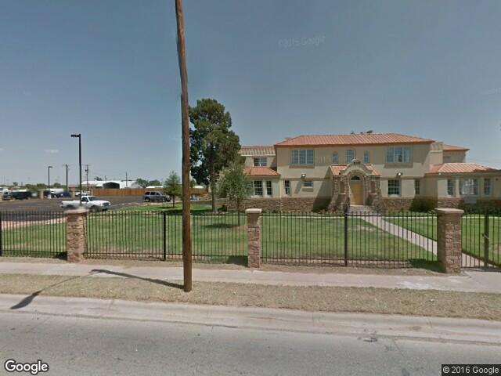
Ector County ISD
Housing for teachers
31 units at Barbara Chancellor House

Slide 6
Ector county isd housing for teachers
School purchased home for $3.1 million
  31 apartment rooms
  2 Stories/ doors face interior
  200-400 sq. ft.
  $500-$950 per month
  Each unit has full kitchen and is furnished
  Flat screen T.V. / Wi-Fi/Cable
  Each floor has 4 washers and dryers
Basement includes:
  Large meeting room/Study room/Theater room
  Ping pong room/Gym
  Rest room
  3 extra rooms
For all incoming and current ECISD teachers
Rent is deducted from pay check

Slide 7
Los Angeles
Unified School District
Sage Park Apartments built on excess land adjacent to Gardena HS.
District donated land; housing developer handled financing, construction and management.
For LAUSD employees, including bus drivers, maintenance workers, and substitute teachers.
1, 2, 3 bedroom apartments.
Income 30 – 60% of area’s median income (ranges from $16,541 to $49,800 for a 4-person household).
Rents between $425 and $1,222.
6,000 district employees on waiting list.

Slide 8
Additional LAUSD developments
In Hollywood
  $33M
  66 unit
  4 story complex
  Built above a primary school car park
South of downtown LA
  29-unit project to be open in 2017 or 2018
Issue – teachers may not qualify for housing because the financing available to developers is geared towards providing housing to very low income individuals.

Slide 9
San Francisco
Unified School District
In October 2015, mayor released 5-year plan to offer housing assistance to 500 teachers by 2020.
Forgivable housing loans, around $250,000 annually for housing counseling.
New affordable housing for 100 teachers.
Voters approved $310 million bond to allow city to pay for affordable housing.
  $50 million for maintaining and building affordable housing.
  $5 million to be set aside to replenish the Teacher Next Door program, which gives teachers $20,000 loans to buy their first home in the city. If the teacher remains in the district for 10 years, the loan is entirely forgiven.

Slide 10
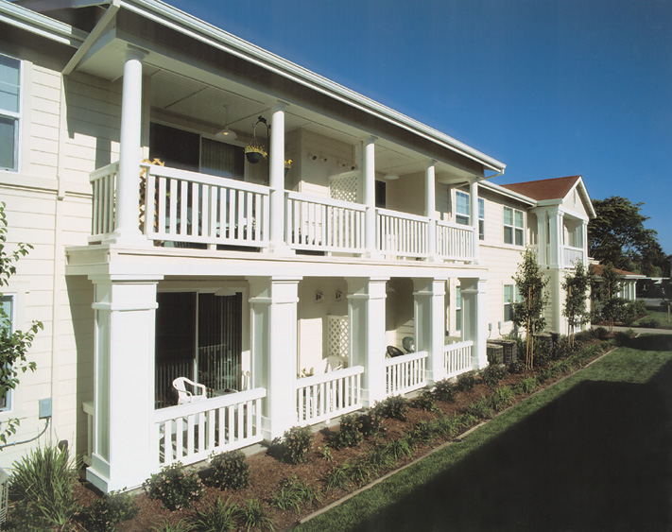
Santa clara unified school district
Casa del Maestro

Slide 11
Santa Clara
Unified School District
Public-private partnership with non-profit corporation.
First 30 units of Casa del Maestro — House of the Teacher — opened in 2005, with another 40 opening in 2009.
$980 - $1,400 per month, about half the cost of a typical one-bedroom in Santa Clara.
Lottery
Teacher turnover rate of about 8 % compared to 40% turnover rate for teachers hired at the same time that didn't live at Casa del Maestro.

Slide 12
Other school district initiatives
Rio Arriba County, New Mexico considering plan to redevelop an old school site as a mixed-use affordable housing project.
Ferndale School District outside Detroit planning to sell a former community center to an affordable housing developer for a mixed-income project that would create 60 new housing units.
Teton County School District in Jackson Hole, WY recently partnered with a housing trust to use donated land to develop 11 moderately priced homes, some of which set aside for teachers.

Slide 13
AISD
Average teacher salary is $52,996.50
With FICA included, salary is $56,282.50

