Slide 1
Sustainability in AISD Coordinated School Health
Darien Clary | Director of Sustainability | darien.clary@austinisd.org 512.414.3042
Notes:
Link: 2021-2022 The Austin ISD Big Book of Recommended Strategies For Campus and Targeted Improvement Plans - see p. 8 “physical Environment/Sustainability”
https://www.austinisd.org/cda/campus-improvement-plans
Each school year the principal of each campus, with the assistance of the Campus Advisory Council, must develop, review and revise the Campus Improvement Plan (CIP). The purpose of this plan is to improve student performance on the state’s student achievement indicators for all student populations, as well as improve performance on any other performance measures for special needs populations. The campus improvement plan is supportive of the objectives of the district's Strategic Plan.
General timeline
Principals and schools develop their plans in August and September. Some items in the CIP are mandatory for a school,, others are optional.
In October, schools may receive feedback on their plan and may make some revisions.
In November, plans are made available on the school’s website and the school works on targeted strategies throughout the year.

Slide 2
Celebrate AISD Earth Week! April 18-22
Visit austinisd.org/earthweek to find fun and meaningful ways to take action!
Earth Day Bingo
Earth month eco-action calendar
More Earth Week activities for work and home!
Notes:
How to become a National Wildlife Federation Eco-School: Students, teachers, and staff can use the framework to make positive, lasting change in your school community and take steps towards your Green Flag certification!
Earth Day Bingo: Download the Earth Day Bingo Card, available in English and Spanish, to see how many eco-actions you can do from school, home, your backyard, and on a walk.
Earth Week Activities: Check out the activities and tips for families and students of all ages to take action in social & environmental justice, energy and water conservation, zero waste, air quality and nature. These activities can also be used to complete your Earth Day bingo card!
Want to celebrate all month? Check out the City of Austin’s Earth Month activity calendar.

Slide 3
Sustainability in AISD Coordinated School Health
Darien Clary | Director of Sustainability | darien.clary@austinisd.org 512.414.3042
Notes:
Link: 2021-2022 The Austin ISD Big Book of Recommended Strategies For Campus and Targeted Improvement Plans - see p. 8 “physical Environment/Sustainability”
https://www.austinisd.org/cda/campus-improvement-plans
Each school year the principal of each campus, with the assistance of the Campus Advisory Council, must develop, review and revise the Campus Improvement Plan (CIP). The purpose of this plan is to improve student performance on the state’s student achievement indicators for all student populations, as well as improve performance on any other performance measures for special needs populations. The campus improvement plan is supportive of the objectives of the district's Strategic Plan.
General timeline
Principals and schools develop their plans in August and September. Some items in the CIP are mandatory for a school,, others are optional.
In October, schools may receive feedback on their plan and may make some revisions.
In November, plans are made available on the school’s website and the school works on targeted strategies throughout the year.

Slide 4
In these slides:
What is sustainability?
Where can I find sustainability in Coordinated School Health and the Campus Improvement Plans?
10 categories and resource to help
Contact us for support!
Tip: we put resources for you in the “speaker notes” of these slides.

Slide 5
What is Sustainability?

Slide 6
Sustainability:
“Meeting the needs of the present without compromising the ability of future generations to meet their own needs.”
The United Nations Brundtland Commission, 1987
AISD 2011 Environmental Sustainability Policy

Slide 7
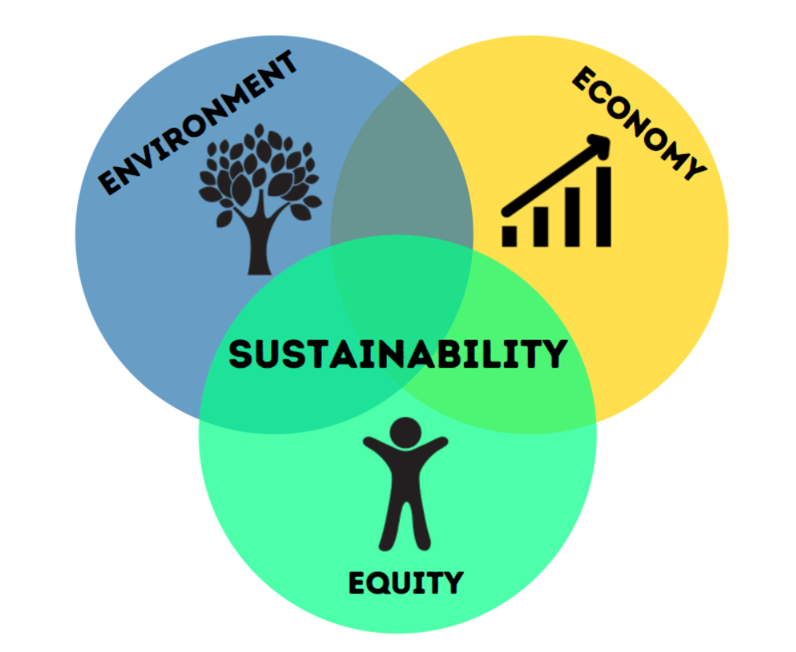
Notes:
Another way to view the concept of sustainability is through the Seven Generations Teaching which is an Iroquoius principle that states that we should make decisions about how we live today based on how our decisions will impact the future seven generations. As it relates to our natural environment, the principle urges us to consider how our choices and behaviors will impact the availability and quality of natural resources including the food we eat, the water we drink, energy that fuels our lives, and the air we breathe.
Resource:
Watch this video on the Seventh Generation Principle with fellow staff or students to begin a conversation about sustainability.

Slide 8
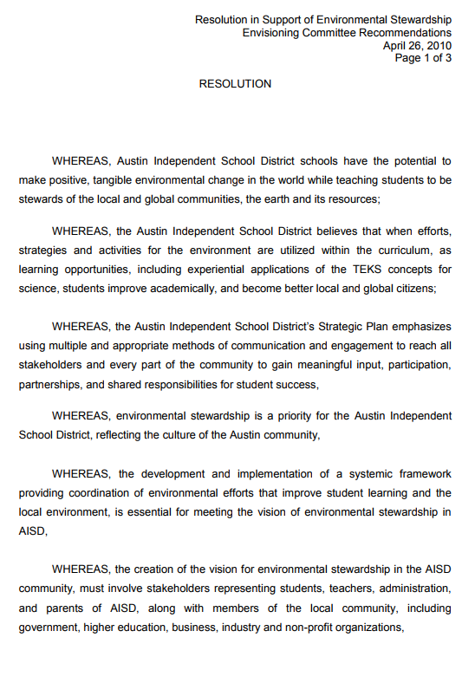
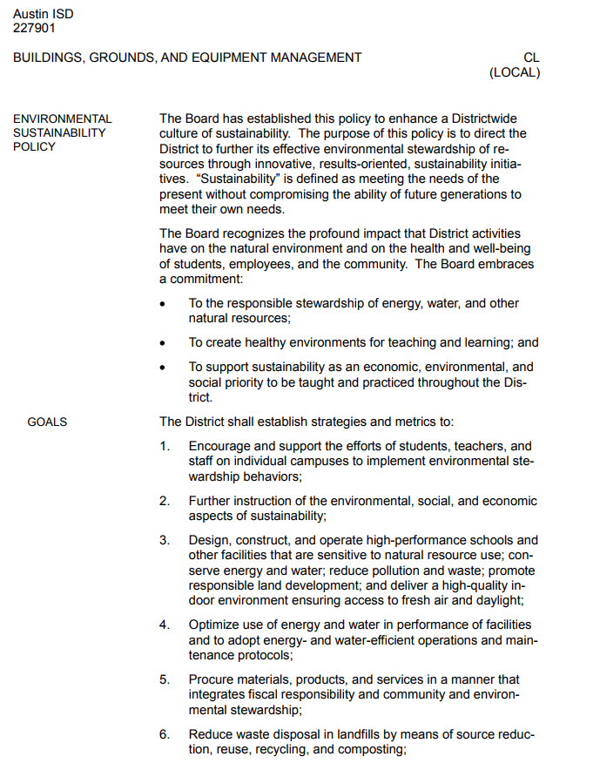
Sustainability @ Austin ISD
2010 Resolution
&
2011
Environmental Sustainability Policy
Notes:
Included in 2011 Environmental Sustainability Policy: https://www.austinisd.org/sites/default/files/dept/sustainability/docs/ESAC_EnvironmentalSustainabilityPolicy_06292011.pdf
Outlines Board of Trustees’ commitment to:
Responsible stewardship of energy, water, and other natural resources;
Create healthy environments for teaching and learning;
Support sustainability as an economic, environmental, and social priority to be taught and practiced throughout the District.
2. The District shall establish strategies and metrics to:
1. Encourage and support the efforts of students, teachers, and staff on individual campuses to implement environmental stewardship behaviors;
2. Further instruction of the environmental, social, and economic aspects of sustainability;
3. Design, construct, and operate high-performance schools and other facilities that are sensitive to natural resource use; conserve energy and water; reduce pollution and waste; promote
responsible land development; and deliver a high-quality indoor environment ensuring access to fresh air and daylight;
4. Optimize use of energy and water in performance of facilities and to adopt energy- and water-efficient operations and maintenance protocols;
5. Procure materials, products, and services in a manner that integrates fiscal responsibility and community and environmental stewardship;
6. Reduce waste disposal in landfills by means of source reduction, reuse, recycling, and composting;
7. Increase efficiency and reduce the environmental burden of staff, faculty, and student transportation; and
8. Support the development of benchmarks, time lines, metrics, third-party verification, and the expectation of evaluation in each of the above areas.

Slide 9
Sustainability @ Austin ISD
Teaching & Learning
Infrastructure & Operations
Community Engagement
Energy
Water
Waste
Procurement
Action Areas
Transportation
Air Quality
Food
Nature
Notes:
At AISD, sustainability takes shape in 8 Action Areas:
Energy conservation and renewable energy
Water conservation and quality
Sustainable transportation
Outdoor air quality and climate change
Indoor air quality and environmental health
Environmentally responsible purchasing
Waste minimization, recycling, and composting
Sustainable food and outdoor spaces
These are carried out through Teaching and Learning, Infrastructure and Operations, and Community Engagement for a whole-District approach to Sustainability.

Slide 10
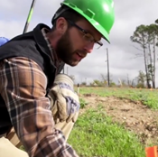
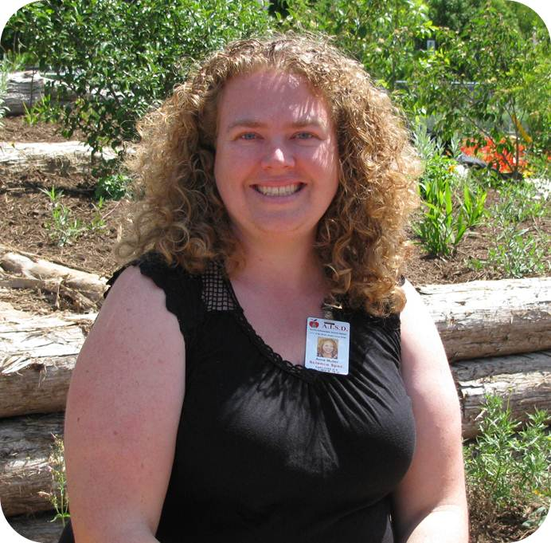
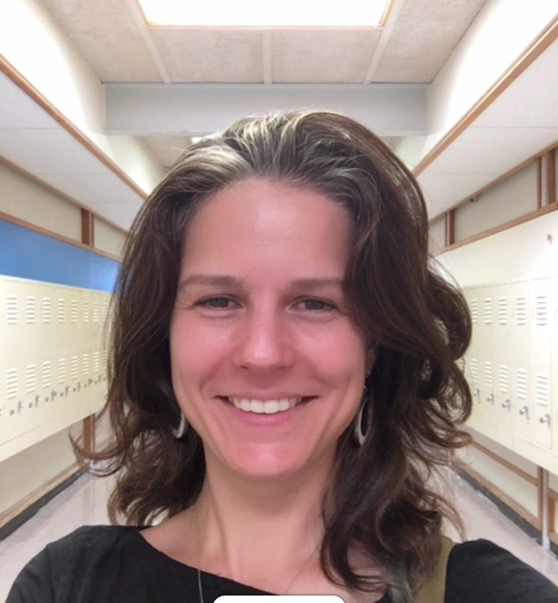
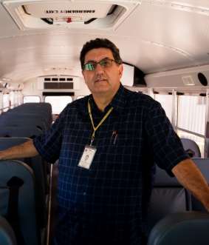
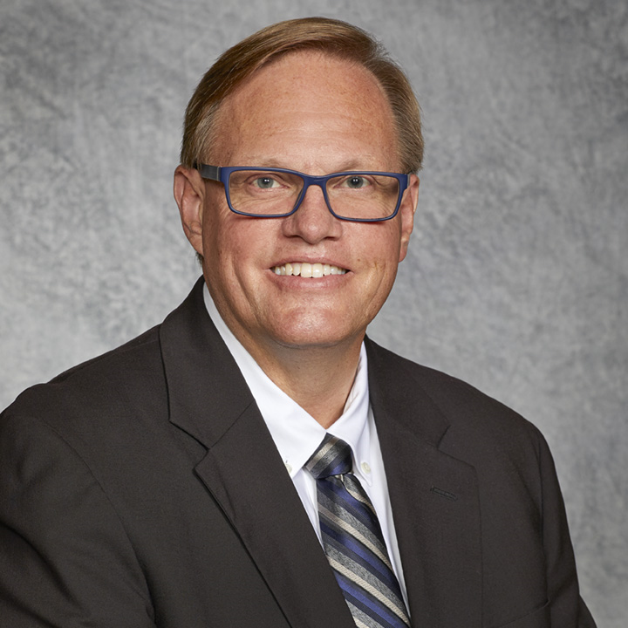
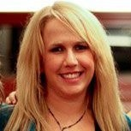
Matt Mears
Urban Forester
MEET THE TEAM
SUSTAINABILITY
Diane Grodek
Executive Chef
Darien Clary
Sustainability Manager
Anne Muller
Outdoor Learning Specialist
AISD SUSTAINABILITY
LEADERSHIP
Amanda Mortl
Zero Waste Specialist
Mike Rios
Assistant Director of Transportation & Vehicle Services
Rey Torres
Energy & Water Manager
Reach out if you have questions. We’re happy to help! Find us each in the AISD Directory or email sustainability@austinisd.org
Kris Hafezizadeh
Executive Director of Transportation & Vehicle Services
Mark Ford
Energy Leadership Operations - Performance Services
10
Ana Echeverria
Energy Conservation Specialist
Rebecca Cohen
Environmental Safety Foreman
Notes:
Meet the team! We are district-level staff committed to supporting campus sustainability. Please don’t hesitate to reach out to us as you continue to engage your school and students in sustainability. We are here to help.

Slide 11
Sustainability in AISD Coordinated School Health
Notes:
Link: 2021-2022 The Austin ISD Big Book of Recommended Strategies For Campus and Targeted Improvement Plans - see p. 8 “physical Environment/Sustainability”
https://www.austinisd.org/cda/campus-improvement-plans
Each school year the principal of each campus, with the assistance of the Campus Advisory Council, must develop, review and revise the Campus Improvement Plan (CIP). The purpose of this plan is to improve student performance on the state’s student achievement indicators for all student populations, as well as improve performance on any other performance measures for special needs populations. The campus improvement plan is supportive of the objectives of the district's Strategic Plan.
General timeline
Principals and schools develop their plans in August and September. Some items in the CIP are mandatory for a school, others are optional.
In October, schools may receive feedback on their plan and may make some revisions.
In November, plans are made available on the school’s website and the school works on targeted strategies throughout the year.

Slide 12
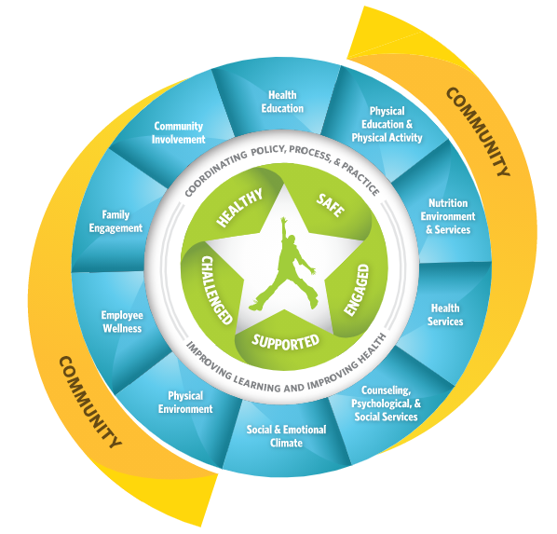
CIP Section: Coordinated School Health
Notes:
Link: 2021-2022 The Austin ISD Big Book of Recommended Strategies For Campus and Targeted Improvement Plans - see p. 8 “physical Environment/Sustainability”
Campus Improvement Plans:
Each school year the principal of each campus, with the assistance of the Campus Advisory Council, must develop, review and revise the Campus Improvement Plan (CIP). The purpose of this plan is to improve student performance on the state’s student achievement indicators for all student populations, as well as improve performance on any other performance measures for special needs populations. The campus improvement plan is supportive of the objectives of the district's Strategic Plan.
The Campus Improvement Plan:
assesses the academic achievement of all students
sets the campus performance objectives
identifies how campus goals will be met
determines the resources and identifies the staff needed to implement the plan
sets time lines for reaching the goals
measures progress
provides for a program to encourage parental involvement
includes goals and methods for violence prevention and intervention on campus

Slide 13
CIP Section: Coordinated School Health
Physical Environment/
Sustainability
Notes:
Link: 2021-2022 The Austin ISD Big Book of Recommended Strategies For Campus and Targeted Improvement Plans - see p. 8 “physical Environment/Sustainability”
Coordinated School Health- Physical Environment: A healthy and safe physical school environment promotes learning by ensuring the health and safety of students and staff. The physical school environment encompasses the school building and its contents, the land on which the school is located, and the area surrounding it. A healthy school environment will address a school’s physical condition (e.g., ventilation, moisture, temperature, noise, and natural and artificial lighting), and protects the health of occupants.

Slide 14
10 Categories of Physical Environment/Sustainability
Green Team
Energy
Water
Zero Waste
Food
Nature
Transportation
Air Quality
Professional Development
Innovation
Notes:
We’ll walk through these 10 categories and it may spark some ideas for ways you can dive in - or perhaps you already are and you can document your work in the CIP. (this process can support the work you are already doing)

Slide 15
Pssst! The following categories in the Coordinated School Health can also help you transform your school into a teaching tool for hands-on PBL that provides an opportunity for learners to engage in real-world scenarios, helping them to become leaders and change-makers in their community. Engage your students as you implement these strategies!
Notes:
It is especially exciting because it is where operations/construction/facilities meet student learning. We are all here for the purpose of student learning.
As we move through the 10 categories, contemplate opportunities to engage students across many content areas (arts, student government, science, humanities, STEAM)

Slide 16
10 Categories of Physical Environment/Sustainability
Green Team
Identify a green team lead - sign up! bit.ly/AISDgreenChamp
Build the team & invite others!
The green team can help with your CIP actions and other sustainability initiatives at your school, perhaps even aim for becoming a National Wildlife Federation Green Flag School!
Notes:
Resources: Green Team Strategies
In Q1, identify a Green Team Lead or Campus Sustainability Champion to review artifacts in the CIP, identify recommended strategies, and organize any green team activities at the school. (resource: NWF Eco-School Handbook, evidence = Green Team Lead sign up).
Establish a Green Team in alignment with NWF Green Flag Eco-team guidelines: The Green Team consists of at least 50% students, and also includes, teachers, staff, and community members; The team meets at least 8 times a year; Students take significant responsibility for conducting the Green Team meetings and the team's decision-making process; Students share responsibility for keeping minutes for each meeting and communicating information to the whole school; Student representatives actively engage other students and collect suggestions from the greater student body.
Write an action plan based on the eco-audit, and monitor progress

Slide 17
10 Categories of Physical Environment/Sustainability
Energy
Water
Track your building energy & water use & conduct an audit (see utility data at bit.ly/AISDSaves)
Display AISD Energy Conservation poster in all rooms & water saving reminders at sinks
Start a student energy patrol using Watt Watchers of Texas
Notes:
Resources: Energy Strategies
Track your building energy use and conduct an energy audit that fulfills the NWF Eco-Schools Energy Pathway.
Ensure the energy conservation poster is displayed in all rooms.
Ensure the Green Team establishes a school patrol program to find energy waste utilizing the Watt Watchers of Texas guidance and resources.
Resources: Water Strategies
Track your building water use and conduct a water audit that fulfills the NWF Eco-Schools Water Pathway.
Post Water Conservation Signs at every sink and water fountain

Slide 18
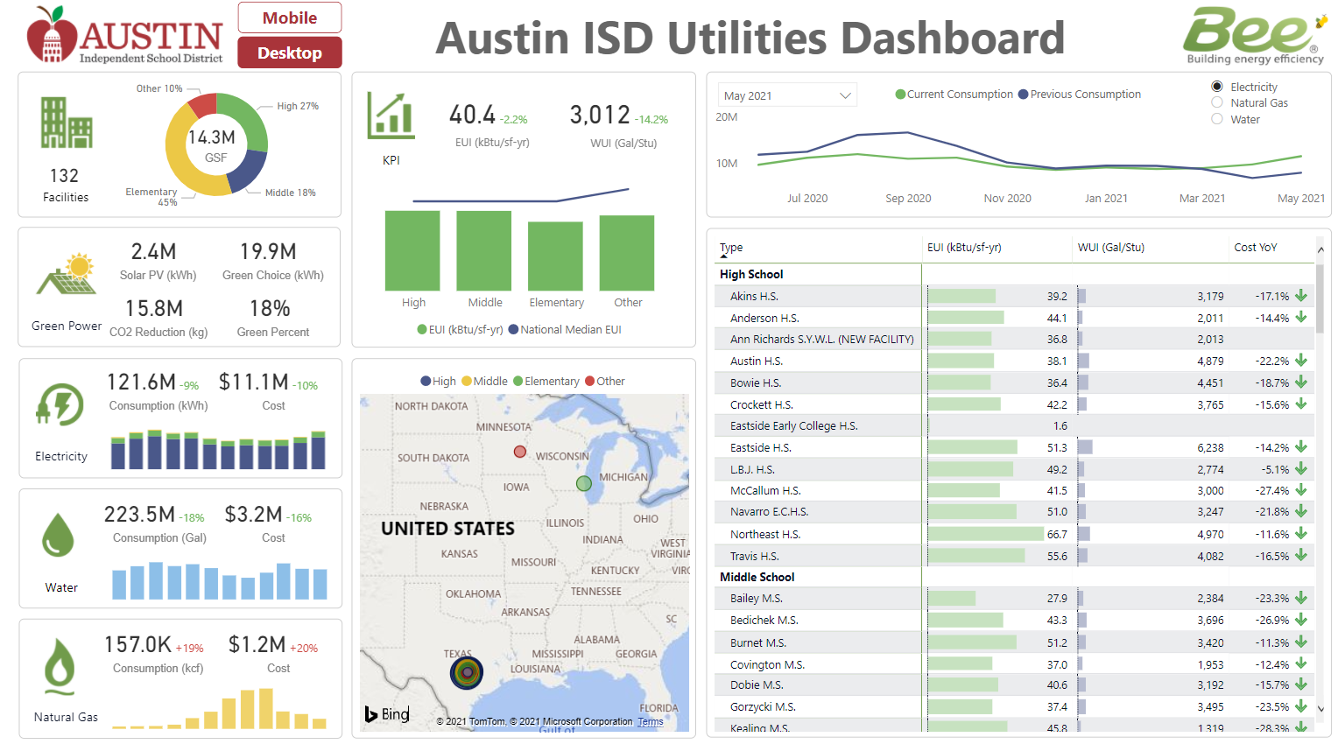
Track your building energy & water use & conduct an audit with students bit.ly/AISDSaves
Notes:
Resources: Energy Strategies
Track your building energy use and conduct an energy audit that fulfills the NWF Eco-Schools Energy Pathway.
Ensure the energy conservation poster is displayed in all rooms.
Ensure the Green Team establishes a school patrol program to find energy waste utilizing the Watt Watchers of Texas guidance and resources.
Resources: Water Strategies
Track your building water use and conduct a water audit that fulfills the NWF Eco-Schools Water Pathway.
Post Water Conservation Signs at every sink and water fountain

Slide 19
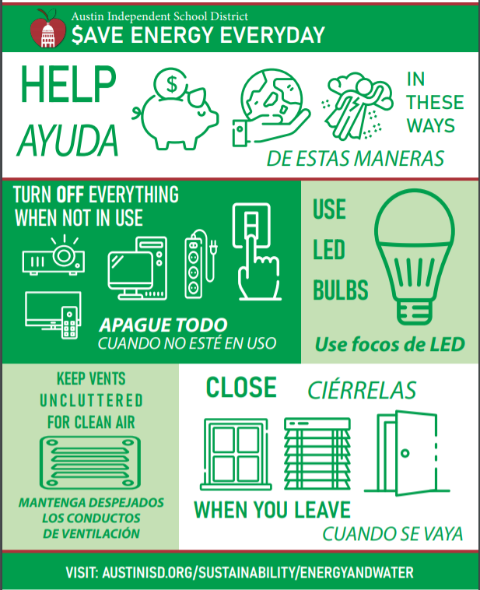
Download the Energy conservation poster to post in your rooms tinyurl.com/SaveEnergyPoster
Notes:
Resources: Energy Strategies
Track your building energy use and conduct an energy audit that fulfills the NWF Eco-Schools Energy Pathway.
Ensure the energy conservation poster is displayed in all rooms. https://tinyurl.com/SaveEnergyPoster
Ensure the Green Team establishes a school patrol program to find energy waste utilizing the Watt Watchers of Texas guidance and resources.
Resources: Water Strategies
Track your building water use and conduct a water audit that fulfills the NWF Eco-Schools Water Pathway.
Post Water Conservation Signs at every sink and water fountain

Slide 20
10 Categories of Physical Environment/Sustainability
Zero Waste
Co-located landfill, Recycle, Compost bins
Compost Collection for Breakfast in the Classroom
Water Bottle Refill stations
Teachers, staff and students take the Zero Waste Campus Best Practices in BLEND
Notes:
Resources: Zero Waste Strategies
Co-located landfill, recycle, and compost bins in the cafeteria or dining area and paired landfill and recycle bins in all classrooms. (see Zero Waste Campus Best Practices BLEND Course, evidence =photos of waste station &, best practices in place, documented on Campus Housekeeping Evaluation Report)
Compost collection for Breakfast in the Classroom (see guide)
All teachers and school administrators take the Zero Waste Campus Best Practices course in BLEND (also available in HCP) (approx 1 hour) (evidence = number of teachers and school administrators that took the course.)
Ensure students take the Zero Waste Blend Campus Best Practices course in BLEND as part of a class activity, Advisory period, or FIT time. (evidence = number of students that took the course.)
The school has water bottle refill stations that meet the American Heart Association Recommendations:
At least one bottle filling station per 100 students
At least one bottle filling station on each floor, wing or other building section of a school building
One bottle filling station in all school food service areas
One bottle filling station near gymnasiums and outdoor learning and activity areas, including playgrounds and athletic facilities

Slide 21
10 Categories of Physical Environment/Sustainability
Nature
Ensure teachers attend outdoor learning PD
Boost outdoor learning with gardens, outdoor classrooms, green infrastructure, nature trail, domestic animal habitats, learning pond, nature, play, etc.
Check out your school’s tree map to take tree walks & include your school trees in learning.
Coordinate with AISD Urban Forester to plant native trees in fall or spring
Notes:
Resources: Nature Strategies
Ensure teachers attend “Outdoor Learning PD” in HCP or other related professional learning opportunities.
Schoolyards include gardens, (vegetable and/or habitat), outdoor classroom, and green infrastructure (rain garden, cistern, etc.). Option: Become a Green Schoolyard by having all of the previously mentioned schoolyard features plus 4 other features . (Nature trail, Animal husbandry, Nature play, Learning pond, etc) for a total of 8 features. Before installation, make sure to check with the Schoolyard Improvement Committee to ensure your location does not conflict with planned construction, underground utilities, critical root zones of trees, etc.
Check out the AISD urban forest webpage and review your campus tree map, take tree walks, and include your trees in daily activities and lesson plans.
Plant native trees in the Fall or Spring (planting season is from October - March), and work with the AISD Urban Forester (matthew.mears@austinisd.org) on a planting plan and possible funding avenues.

Slide 22
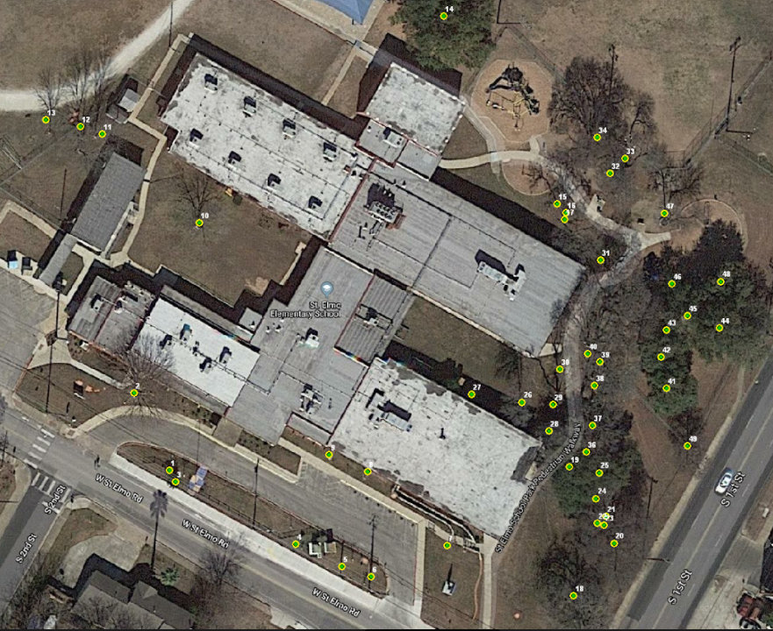
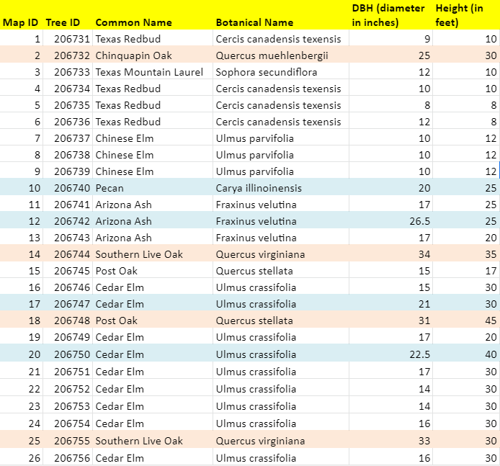
Find your campus tree map! .austinisd.org/sustainability/urban-forest
St. Elmo Elementary Tree Map
Notes:
Resources: Nature Strategies
Ensure teachers attend “Outdoor Learning PD” in HCP or other related professional learning opportunities.
Schoolyards include gardens, (vegetable and/or habitat), outdoor classroom, and green infrastructure (rain garden, cistern, etc.). Option: Become a Green Schoolyard by having all of the previously mentioned schoolyard features plus 4 other features . (Nature trail, Animal husbandry, Nature play, Learning pond, etc) for a total of 8 features. Before installation, make sure to check with the Schoolyard Improvement Committee to ensure your location does not conflict with planned construction, underground utilities, critical root zones of trees, etc.
Check out the AISD urban forest webpage and review your campus tree map, take tree walks, and include your trees in daily activities and lesson plans.
Plant native trees in the Fall or Spring (planting season is from October - March), and work with the AISD Urban Forester (matthew.mears@austinisd.org) on a planting plan and possible funding avenues.

Slide 23
10 Categories of Physical Environment/Sustainability
Food
Encourage students, teachers, and families to eat school meals. This supports continuation of sustainably-sourced food (grass-fed beef, organic milk, etc.)
Register your school garden for Garden to Café
Invite Food Services staff to talk about the food programming at PTA meetings, share in celebrations & activities
Notes:
Resources: Food Strategies
Encourage students to get their breakfast and lunch from the cafeteria! Read the daily menu at morning announcements or assembly to show your support. Connect with parents to let them know the Cafes serve healthy, well-sourced, scratch made food and have vegetarian options daily.
If you have a school garden and have a team that can support it, consider getting it certified to be part of the "Garden to Cafe" program. This program allows for food grown in the garden to be served in the cafeteria.
Include the Cafeteria team in your staff celebrations and activities. Introduce and encourage the relationship between the kitchen staff and the students and teachers they serve.
If you feel your school could benefit from an in-person or virtual meet and greet at a school event or PTA meeting, reach out to our department to schedule a visit from our Chef, Area Supervisor, or our menu planner/Dietitian.

Slide 24
10 Categories of Physical Environment/Sustainability
Food
Encourage students, teachers, and families to eat school meals. This supports continuation of sustainably-sourced food (grass-fed beef, organic milk, etc.)
Register your school garden for Garden to Café
Invite Food Services staff to talk about the food programming at PTA meetings, share in celebrations & activities
Notes:
Resources: Food Strategies
Encourage students to get their breakfast and lunch from the cafeteria! Read the daily menu at morning announcements or assembly to show your support. Connect with parents to let them know the Cafes serve healthy, well-sourced, scratch made food and have vegetarian options daily.
If you have a school garden and have a team that can support it, consider getting it certified to be part of the "Garden to Cafe" program. This program allows for food grown in the garden to be served in the cafeteria.
Include the Cafeteria team in your staff celebrations and activities. Introduce and encourage the relationship between the kitchen staff and the students and teachers they serve.
If you feel your school could benefit from an in-person or virtual meet and greet at a school event or PTA meeting, reach out to our department to schedule a visit from our Chef, Area Supervisor, or our menu planner/Dietitian.

Slide 25
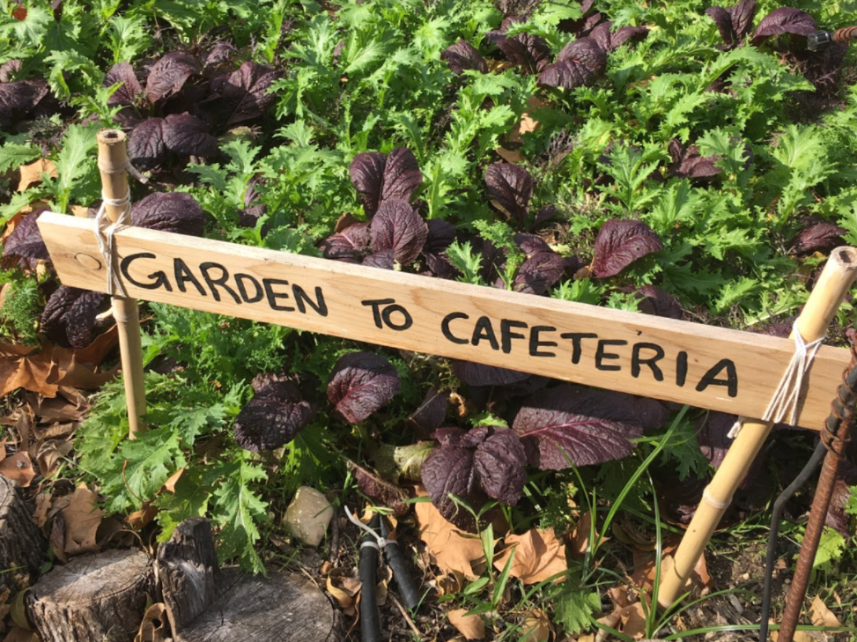
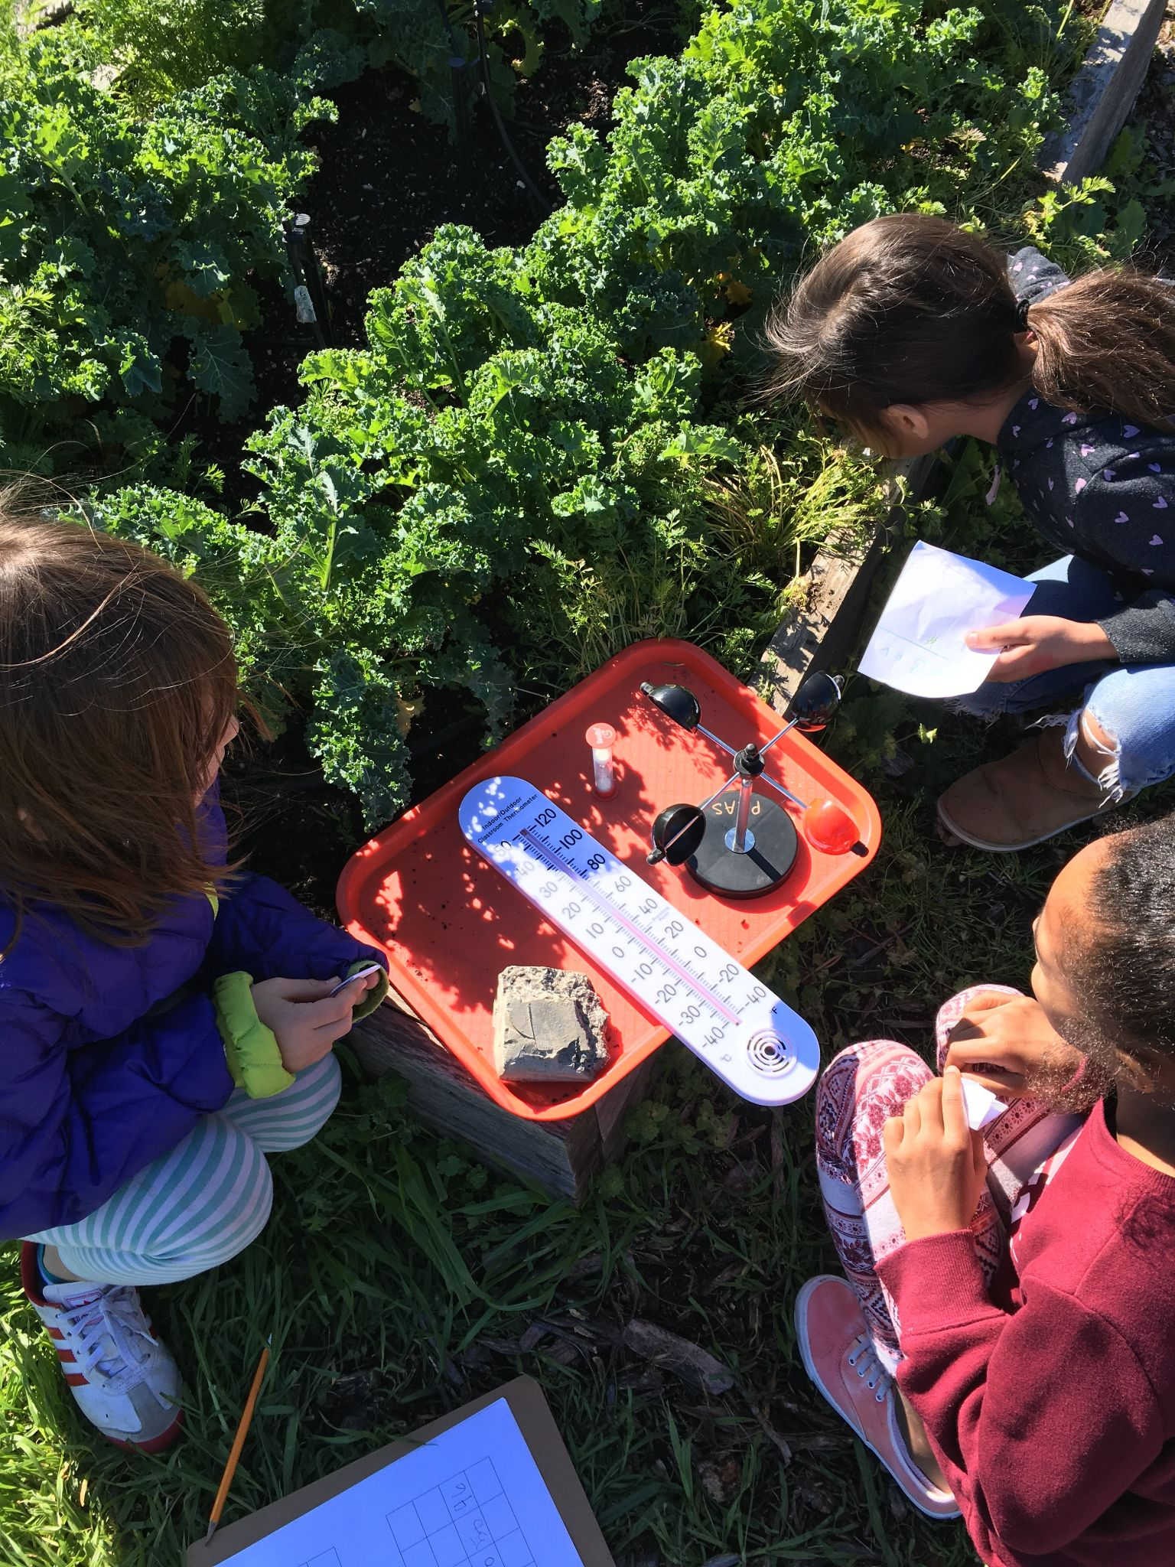
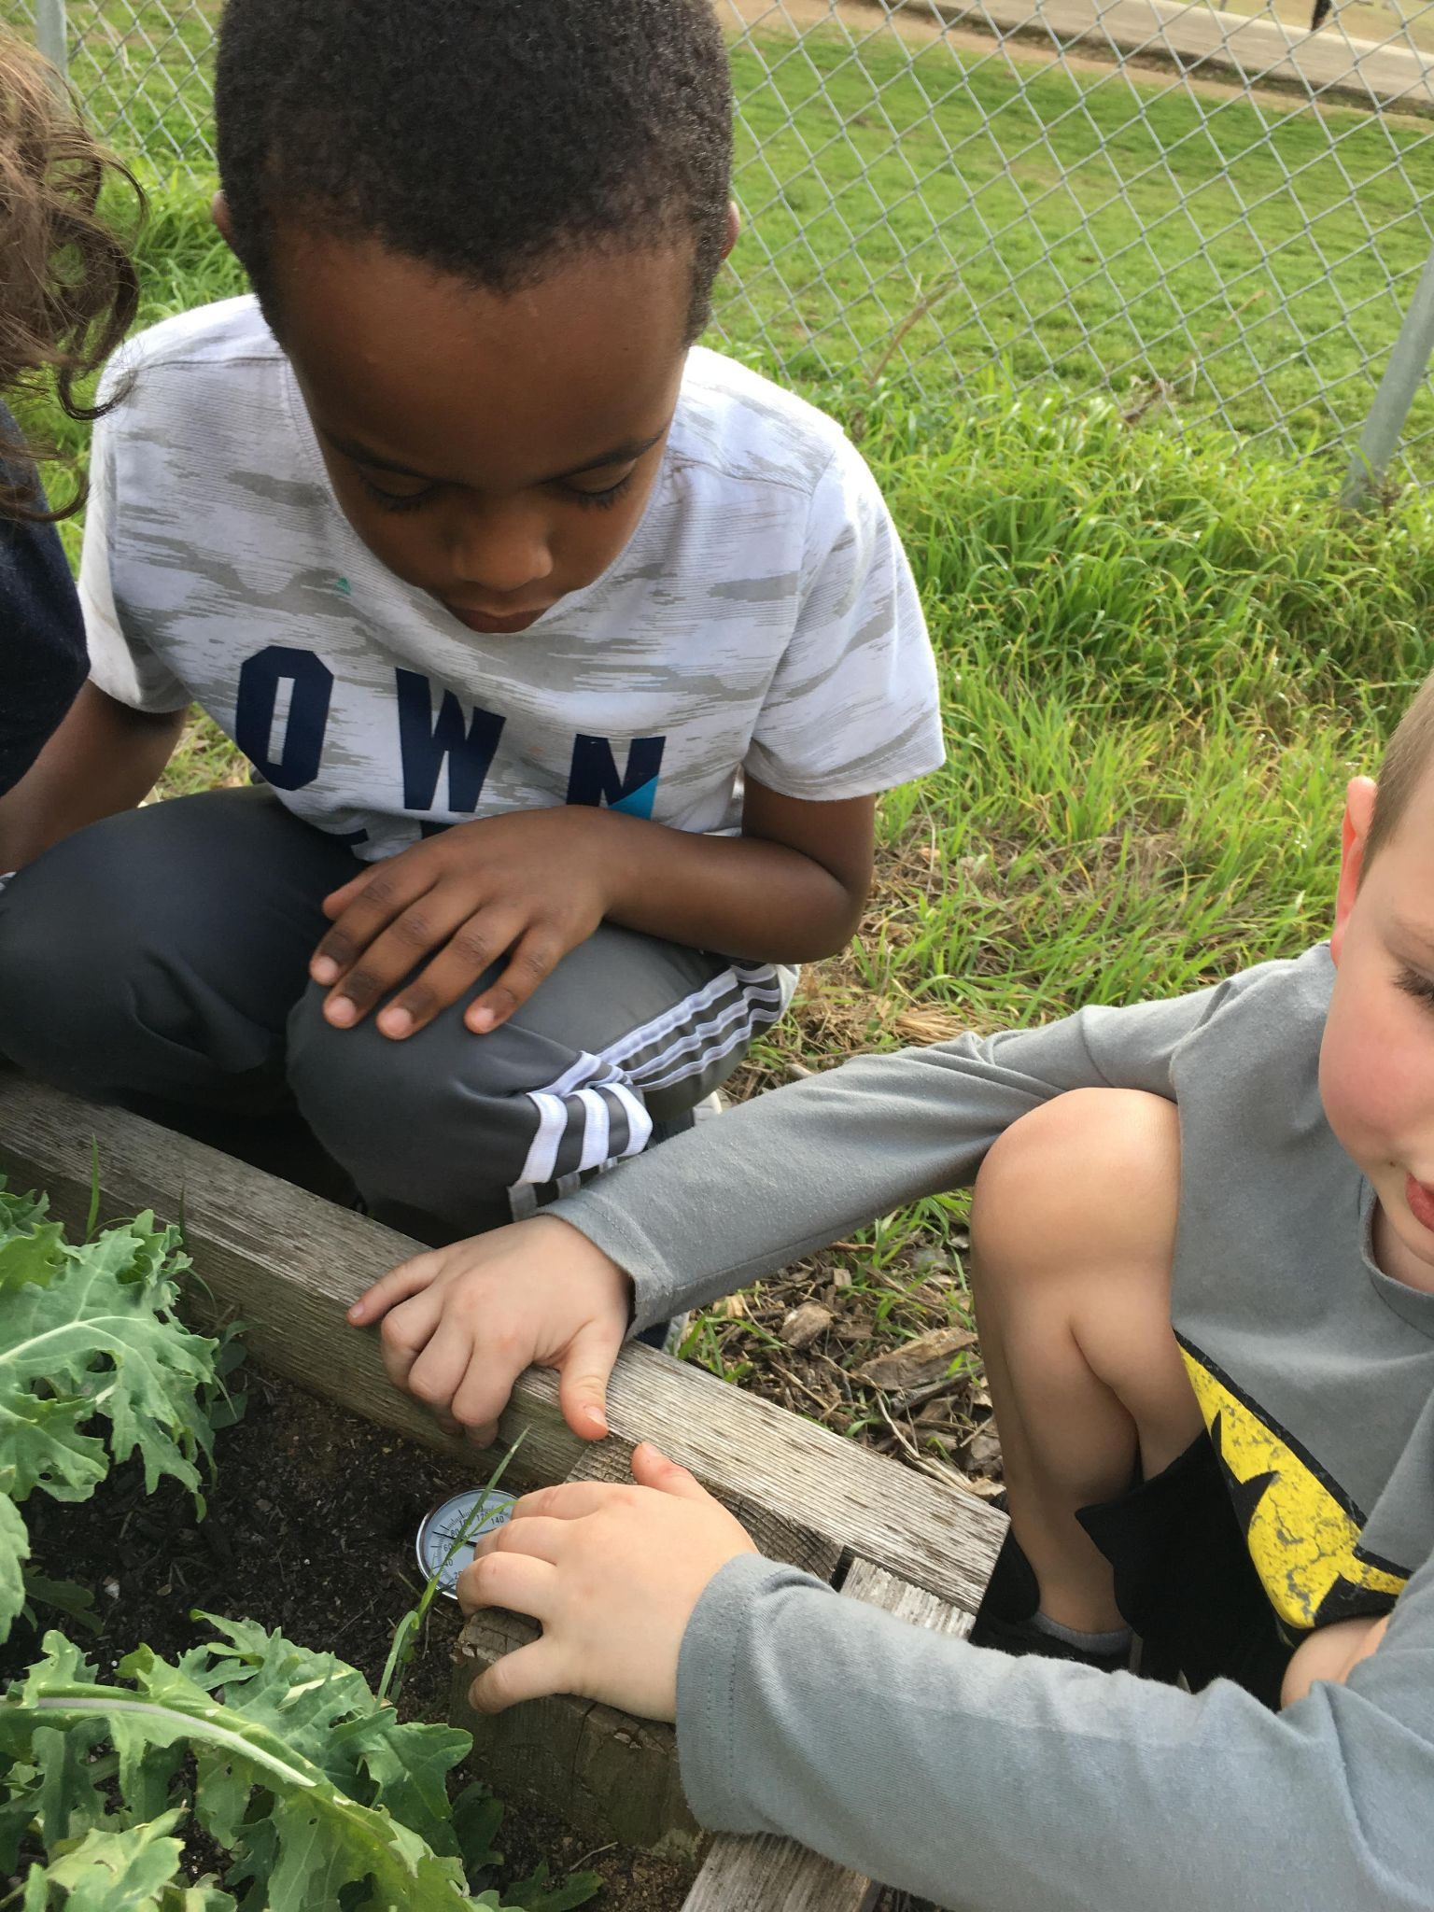
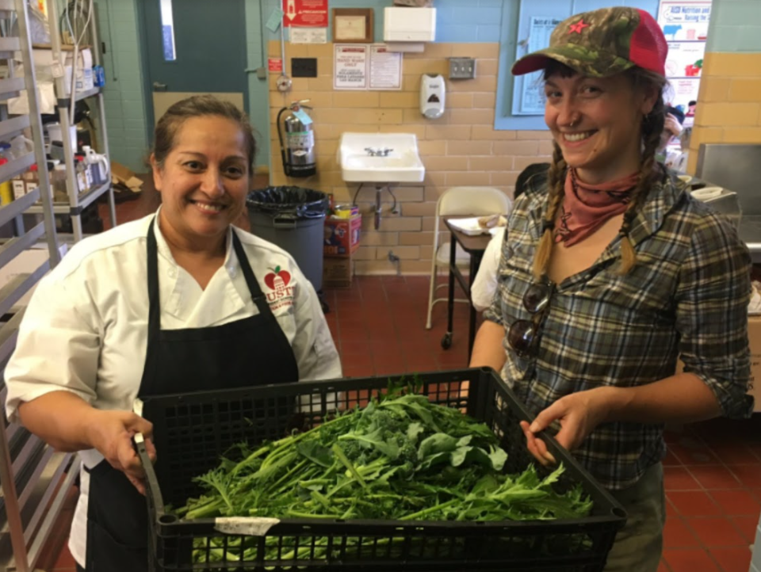
Garden to Cafè
Serve student-grown produce on campus to extend the lessons learned in the garden to the school café.
austinisd.org/nutrition-food-services/initiatives
Notes:
Resources: https://www.austinisd.org/nutrition-food-services/initiatives
Garden to Café
AISD is taking an important leadership role in the school garden movement by partnering with students, community members, teachers and administrators to develop a Garden to Café program that extends the lessons learned in the garden to the school café. Garden to Café is about serving healthy, fresh, garden-grown foods to students through school meal programs.
The AISD Garden to Café Program provides guidelines for schools to help gain approval to serve produce that is grown on campus. Schools requesting this approval will be required to designate a Garden Leader, who will follow the necessary standards and protocols to ensure the garden meets health regulations.
Ensuring the safety of the food supply is critical to student health. School and retail food facilities regulated under the Texas Food Establishment Rules are required to obtain their food from an approved source. Schools requesting to serve food grown in their gardens in the café will be subject to evaluation as outlined in the AISD School Garden to Café Conditions for Use of Garden-Grown Produce in School Kitchens.
Gardens will be reviewed on:
Water quality
Protection from contamination
Sanitary practices
Harvesting procedures

Slide 26
10 Categories of Physical Environment/Sustainability
Air Quality
Display “tobacco Free Campus” signs and “no-Idling” signs prominently
Host programs, messaging, and events that support an idle-free & tobacco-free campus
Follow the AISD Green Cleaning Program to avoid harmful cleaning products that can damage the air we breathe indoors
Notes:
Resources: Healthy Air Quality Strategies to reduce or eliminate indoor and outdoor ground-level air contaminants
The campus has “Tobacco-Free Campus” signs prominently displayed.
The campus has “No-idling” signs prominently displayed at parent drop-off areas.
The school provides lessons/programming/reminders/events that support an idle-free and tobacco-free campus. Air Central Texas is also a great resource.
The school adheres to the District Green Cleaning program and does not use harmful or toxic cleaning agents.

Slide 27
10 Categories of Physical Environment/Sustainability
Transportation
Provide lessons and programming that supports biking and walking (Bike rodeos, walking/biking school bus, Safe Routes to School programming, etc.)
Install bike racks
Notes:
Resources: Transportation Strategies
The campus has bike racks
The school provides provide lessons/programming that support biking and walking (i.e. Bike Rodeo, Safe Routes to School programming, Ghisallo Foundation partnership, etc.)
The school provides regular reminders/events that support biking and walking (i.e. Bike/Walk to School Day, newsletter communications, Safe Routes to School community engagement, etc.)

Slide 28
10 Categories of Physical Environment/Sustainability
Professional Development
Innovation
The campus offers and/or encourages teachers to participate in professional development related to the Physical Environment/Sustainability.
Did the campus identify at least one goal to create a healthy & sustainable school that isn’t mentioned in these strategies? If so, tell us about it!
Notes:
Resources: Professional Development Strategies
The campus offers professional development to teachers in the areas of healthy and sustainable schools (resources: EcoRise Sustainable Intelligence (free to AISD teachers), Green Classroom Professional Training, AISD Zero Waste Best Practices BLEND course, “Outdoor Learning PD” in HCP, Article: The Impact on School buildings on Health & Performance, etc.)

Slide 29
Additional Resources
Become a National Wildlife Federation Green Flag Eco School!
Your activities help earn your Eco School designation.
AISD has over 76 schools that have registered.
3 have achieved the highest award of Green Flag: Patton ES, Small MS, Eastside Memorial HS.
The CIP “Big Book of Strategies” will have all these strategies and links to help implement them
Notes:
Energy Specific Resources https://docs.google.com/presentation/d/1KWI_OZoU8JP_TVRivFs76mY5DGlsyFUtxZgZvhP-euc/edit?usp=sharing

Slide 30
We wish you great success!
(Don’t forget to reach out for help!)

Slide 31
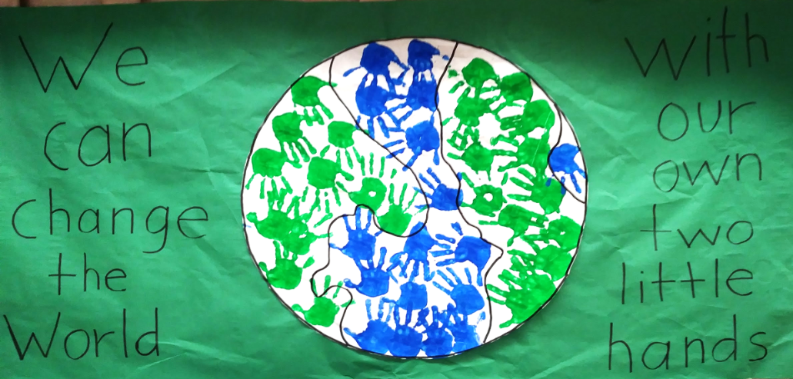
Thank you for all you do to ensure our students are happy, healthy, and smart!

